Slide 1
Night Operations
      Night – definition
      Time between the end of evening civil twilight (sunset) and the beginning of morning civil twilight (sunrise) AIM pg 7
      Night Flight begins one hour after sunset and ends one hour before sunrise
      Night Currency
      - no person shall act as PIC of an aircraft carrying passengers unless within
      the preceding 90 days that person has made at least three takeoffs and three
      landings to a full stop during the period of night flight defined above. FAR 61.57 (b)

Slide 2
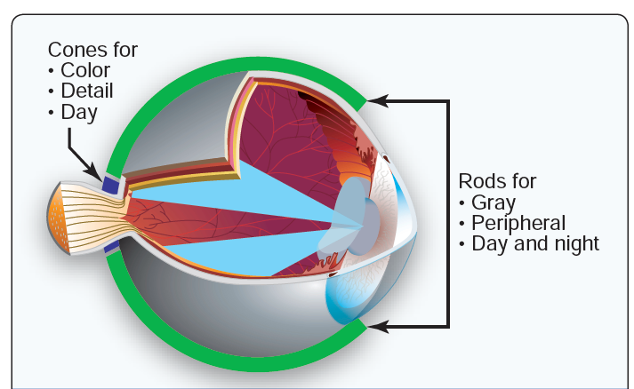
Night Vision

Slide 3
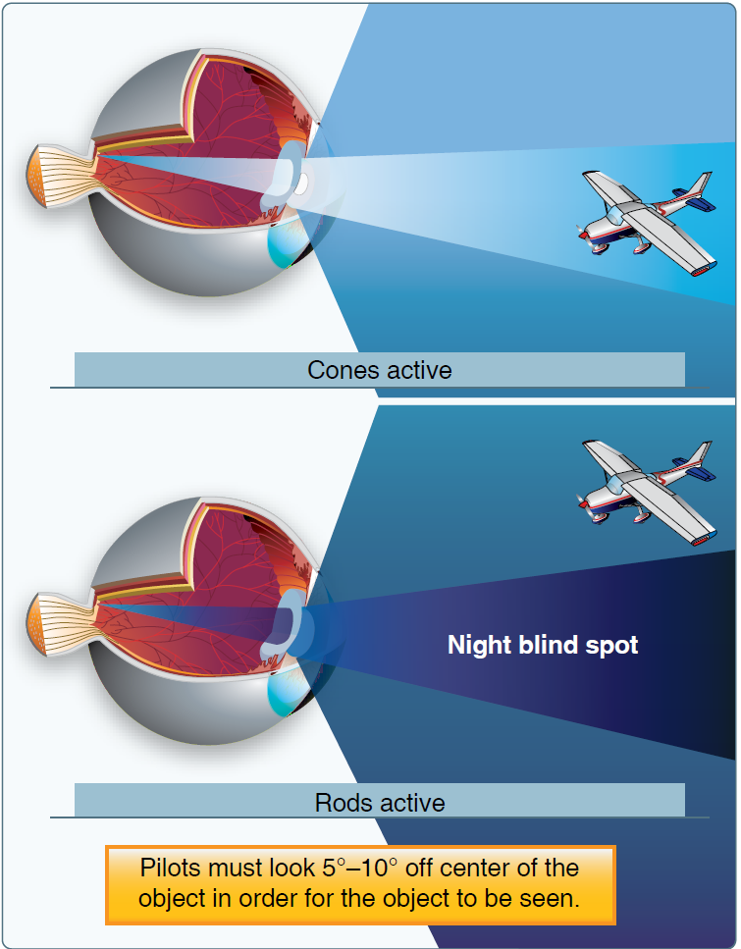
Night Blind Spot

Slide 4
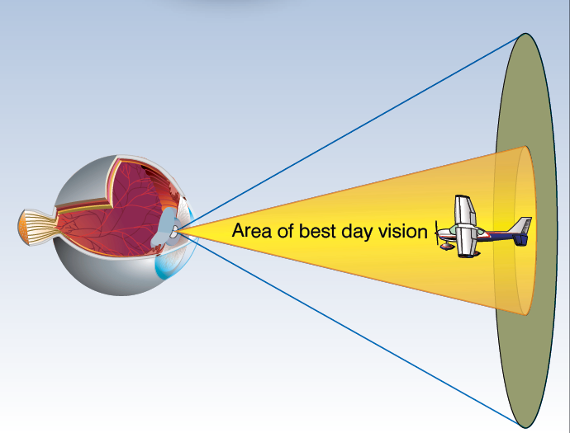
Best Day Vision (Cones active)

Slide 5
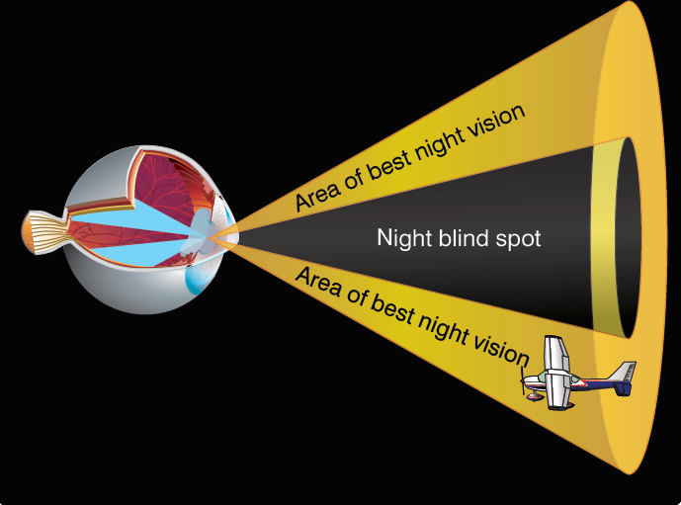
Best Night Vision (Rods active)

Slide 6
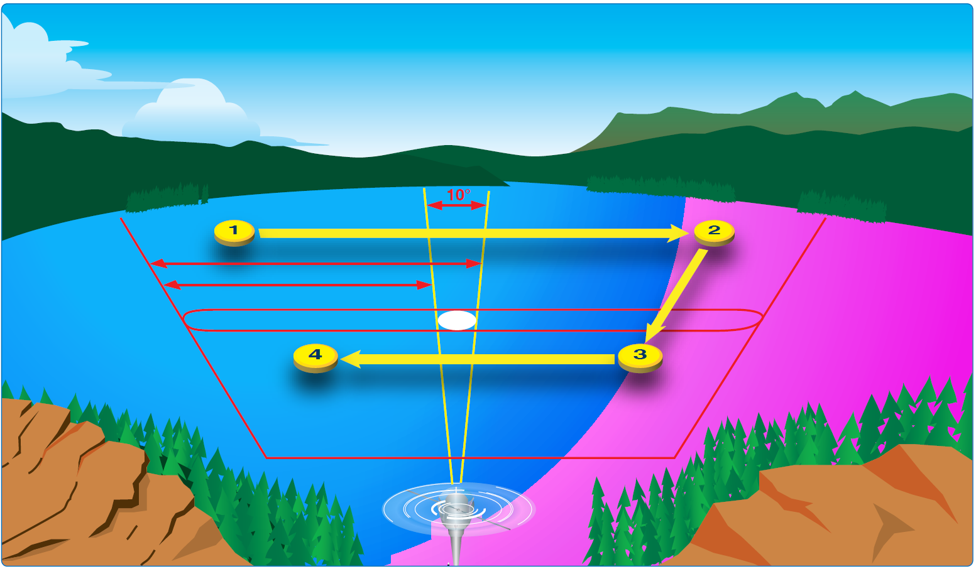
Night Scanning Technique

Slide 7
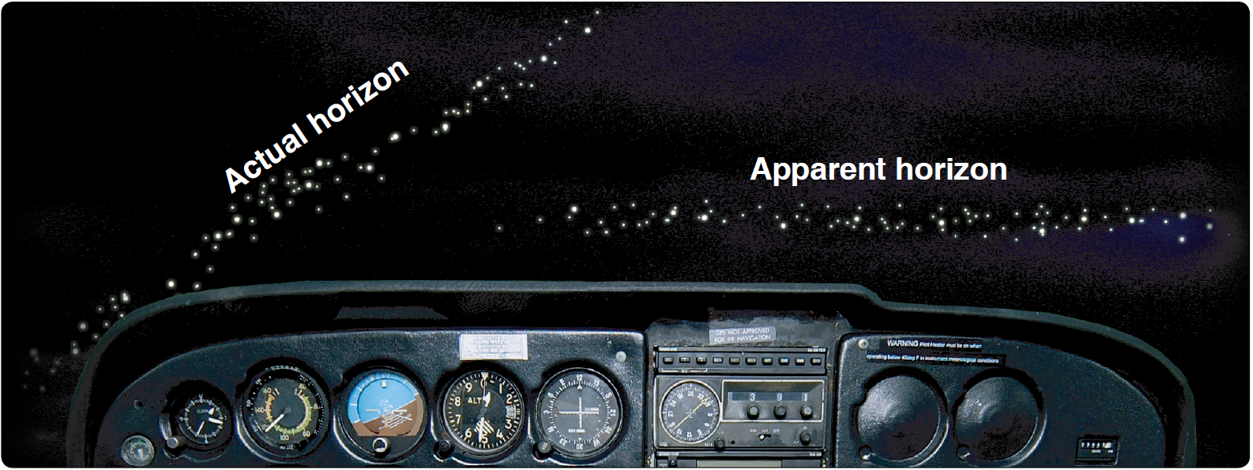
Night Illusions

Slide 8
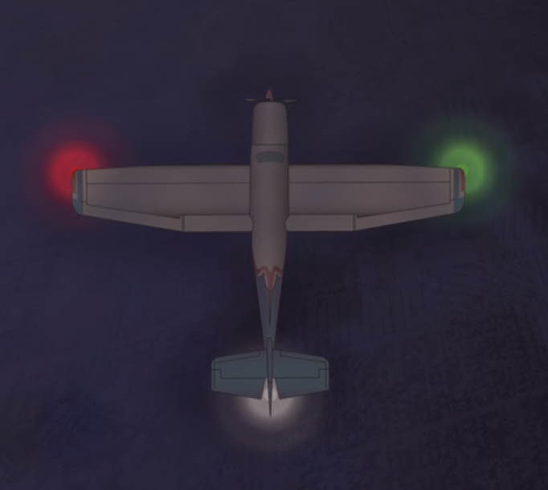
Aircraft Position Lights

Slide 9
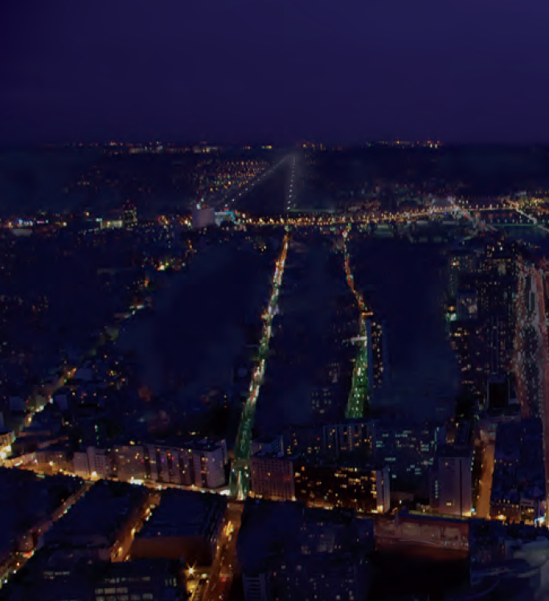
Using light patterns for orientation

Slide 10
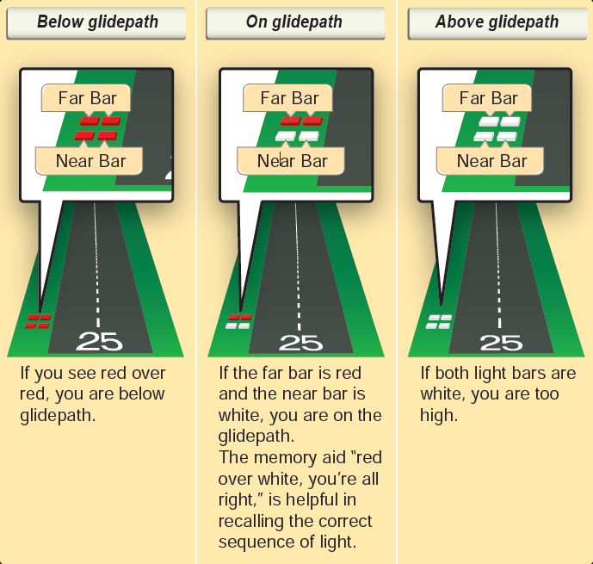
2 Bar Vasi

Slide 11
END

